Slide 1

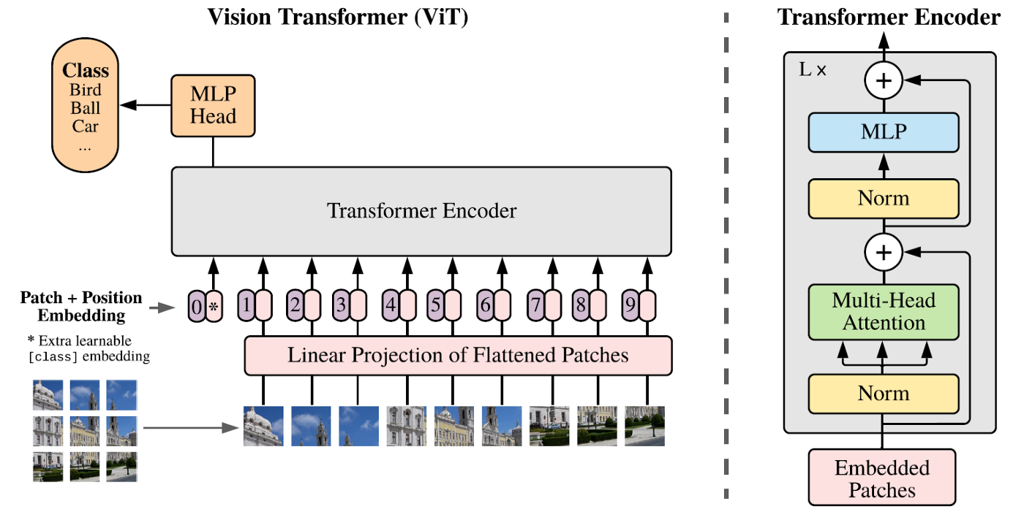
Improving ViT Efficiency for MOT: Dynamic Tokenization
Ug research project
Benjamin Sanati
Fig 1. Vision Transformer model Architecture
Source: A. Dosovitskiy, L. Beyer, A. Kolesnikov, D. Weissenborn, X. Zhai, T. Unterthiner, M. Dehghani, M. Minderer, G. Heigold, S. Gelly et al., “An image is worth 16x16 words: Transformers for image recognition at scale,” arXiv preprint arXiv:2010.11929, 2020

Slide 2
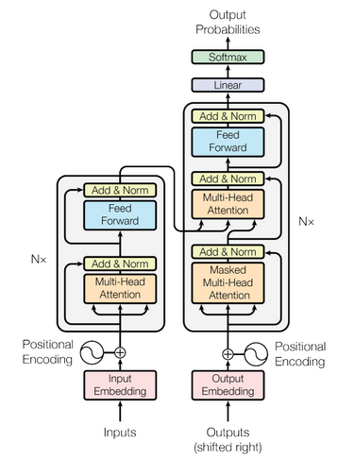

Transformers
Consist of encoder and decoder layers to generate an output sequence
Use attention mechanisms to derive a representation of a sequence and to produce multiple attention scores for each word in the sequence
Self-attention identifies dependencies between different inputs in an input sequence
$$Attention\left(Q, K, V\right)=σ\left(\frac{QK^{T}}{\sqrt{d_{k}}}\right)V$$
Fig 2. Transformer model Architecture
Source: A. Vaswani, N. Shazeer, N. Parmar, J. Uszkoreit, L. Jones, A. N. Gomez, Ł. Kaiser, and I. Polosukhin, “Attention is all you need,” Advances in neural information processing systems, vol. 30, 2017.

Slide 3
Vision Transformers (ViT)
ViTs are altered transformers for CV tasks
An image is split into patches and then tokenized
The tokens are passed to an encoder stack
Encoder output is passed to an MLP head and then classified
ViTs have less inductive bias than CNNs
Self-attention is a global mechanism
Do not possess locality and translational equivariance
Both are present in the CNNs convolution operation
Fig 3. Vision Transformer model Architecture
Source: A. Dosovitskiy, L. Beyer, A. Kolesnikov, D. Weissenborn, X. Zhai, T. Unterthiner, M. Dehghani, M. Minderer, G. Heigold, S. Gelly et al., “An image is worth 16x16 words: Transformers for image recognition at scale,” arXiv preprint arXiv:2010.11929, 2020

Slide 4
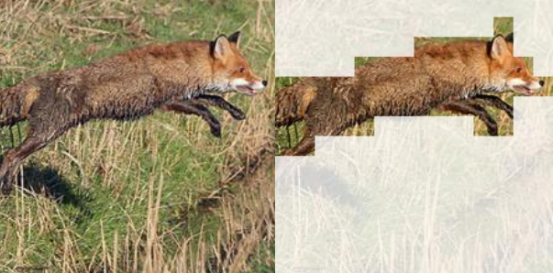
Dynamic Tokenization
An adaptive computation technique
Different inputs have different complexities and therefore computational requirements
Attention is sparse in ViTs
A-ViT identifies spatial redundancy in images
The corresponding redundant tokens are pruned
A-ViT halts the computation for tokens at different
model depths with a prediction module
Prediction module derives a halting score to determine
the tokens to be pruned
A-ViT module shown to prune tokens that are semantically redundant
No extra learnable parameters
Improved model throughput with minimal loss in performance
Fig 4. Example of A-ViT pruning tokens that are semantically redundant
Source: H. Yin, A. Vahdat, J. M. Alvarez, A. Mallya, J. Kautz, and P. Molchanov, “A-vit: Adaptive tokens for efficient vision transformer,” in Proceedings of the IEEE/CVF Conference on Computer Vision and Pattern Recognition, 2022, pp. 10 809–10 818.

Slide 5
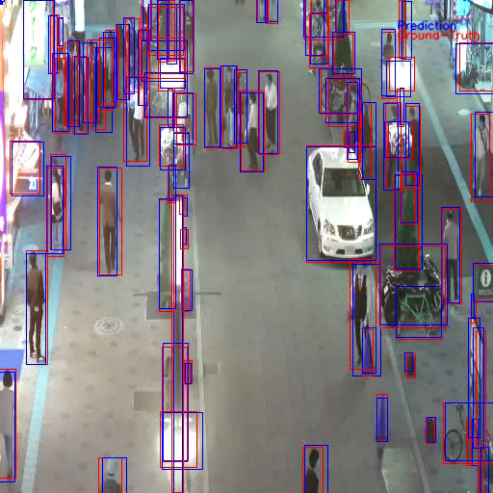
Multiple Object Tracking (MOT)
MOT is a CV task that includes object localization and tracking of its trajectory
Detection Based Tracking (DBT) is the common paradigm used for MOT
Object detector locates objects from the first to last frame
MOT tracker (SORT or DeepSORT) links the objects to trajectories
SORT
Uses a Kalman filter to track objects in image space
Uses the Hungarian algorithm for object matching
Vid 1. Example of a Tracking task with ground-truth and a dummy prediction example

Slide 6
Project Aims
Ambitious project
At the time of writing, little work has been done with ViT object detectors on video inputs
Goals:
Implement a ViT object detector
Deploy model to video feed
Investigate model performance on video feed
Stretch Goals:
Implement a dynamic token sparsification module to dynamically adapt compute during inference
Implement model with DeepSORT to create a DBT

Slide 7
Project Limitations
Limits
Transformers work best as large models → large memory requirements
Transformers require a large amount of data to be trained
Video datasets require a large amount of memory resources
With accessible compute, cannot train a model from scratch
Cannot load and train a model on an entire video dataset
Solutions
Transfer Learning: Load pre-trained transformer model (ViTDet) and use for new task
Reduce video loading compute requirements with sparse temporal sampling

Slide 8
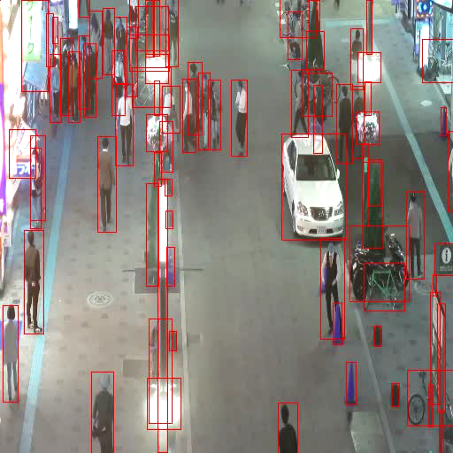

Efficient Video Handling in PyTorch
Video handling in PyTorch requires custom video and label handlers
Must also overcome the large memory requirements of videos in DataLoaders
Returns an $(N, F, C, H, W)$ tensor of $N$ batches and $F$ frames
Use sparse temporal sampling
Allows representative data to be loaded, while being memory and compute efficient
Video is divided into a number of segments
From each segments there are a number of frames selected
Vid 2. An example of a video with sparse temporal sampling

Slide 9
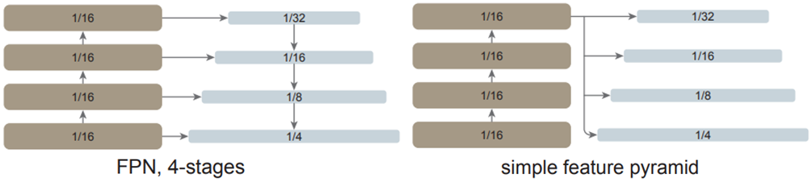
Implementation
ViTDet
An object detector that uses a ViT as a backbone
ViTDet creates a pyramid network (FPN inspired), however, only uses the last feature map → ‘simple feature pyramid’
FPNs optimize the resolution/semantic value trade-off of image sizes
Bounding box predictions acquired by passing resulting heads to mask-RCNN predictor
Set Based Matching: The Hungarian Algorithm
Finds the optimal bipartite matching with the Hungarian algorithm
An optimization problem that reduces the BBox loss and classification loss while matching
Fig 5. FPN compared to ViTDet feature pyramid
Source: Y. Li, H. Mao, R. Girshick, and K. He, “Exploring plain vision transformer backbones for object detection. arxiv 2022,” arXiv preprint arXiv:2203.16527, 2022.

Slide 10

Training and Results
The model is trained on the federated loss function, as stated in ViTDet paper
Adam optimizer used to optimize the model
Improve convergence by also using AMSgrad
Avoid large changes in step size
ViTDet results on the MOT17 test dataset after pre-trained on COCO and trained on MOT17 train dataset
$\text{Average} \text{IoU}=0.77$
$\text{mAP}=0.60$
$\text{Average} \text{inference} \text{time}=0.277\text{s}\text{/}\text{frame}$
FPS will improve when the object detector is integrated with Deep-SORT for a DBT, however, we are interested in the object detectors performance with a video feed

Slide 11
Conclusion and Future Work
Ambitious project, given time frame
A plethora of material learned
Major accomplishments:
Efficient video loading using sparse temporal sampling
ViTDet was trained and implemented on the MOT17 dataset
Transfer Learning from MS COCO pre-trained model
ViTDet was evaluated on a video input feed
An A-ViT module was implemented into a normal ViT for classification
Future work
A-ViT module will be implemented into the ViTDet object detector
Implement object detector with Deep-SORT for improved tracking performance

Slide 12
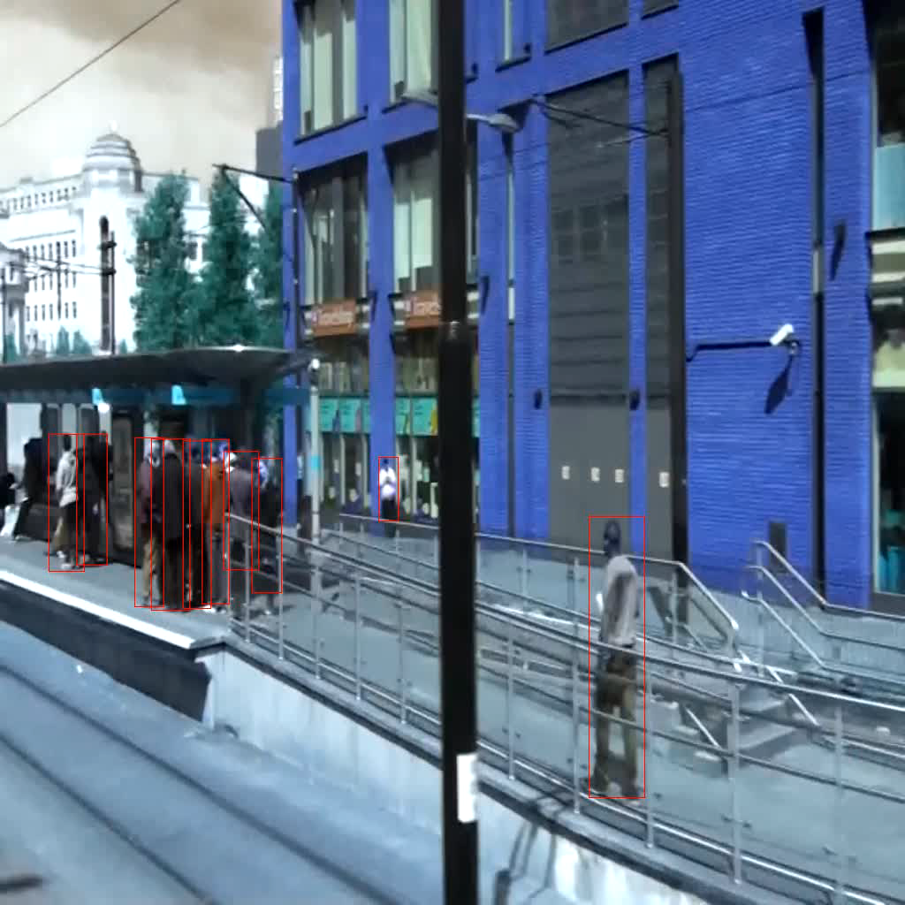
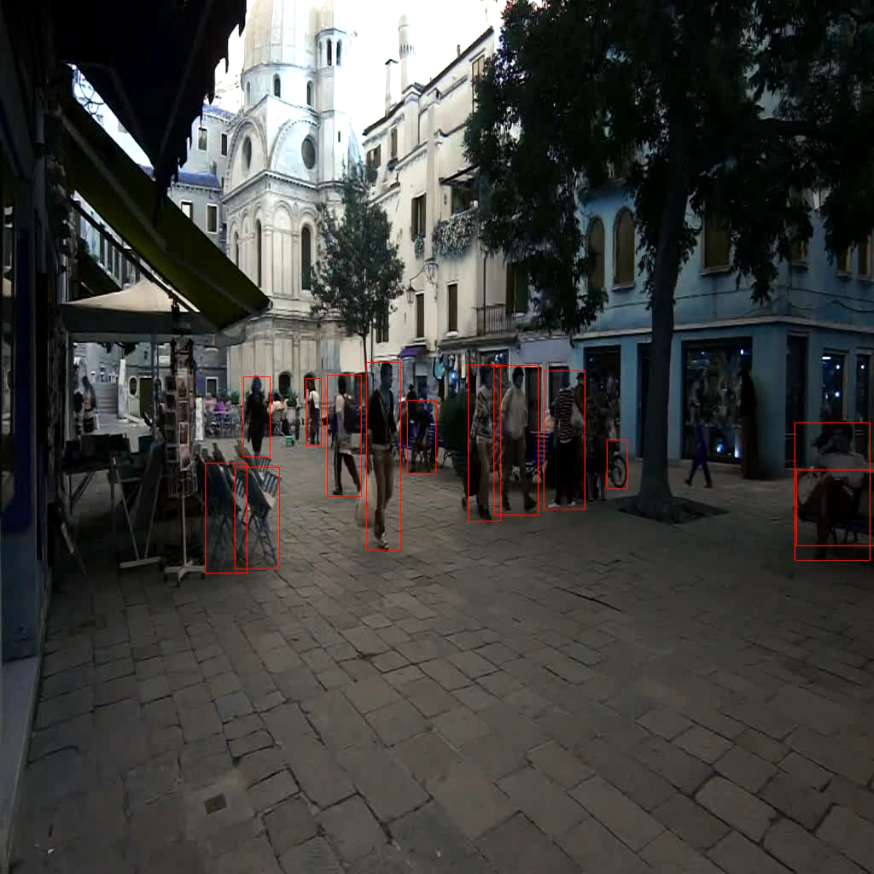
Thank you for listening! Q&A
Vid 3. ViTDet example
Vid 4. ViTDet example

